Slide 1
Introduction to COACH
Dirk Riehle, FAU Erlangen
COACH A01
Licensed under CC BY 4.0 International

Slide 2
Course Goals
Learning objectives
Learn to coach agile teams
Understand the role of the Scrum Master
Understand agile coaching
Understand coaching people and teams
Project objectives
Help one AMOS project perform well

Slide 3
Skills Required for Course
Prerequisites
Successful completion of a past AMOS Project
Required skills
Willingness to apply social competence in project
Good in verbal and written communication
Ability to be observant and hands-off
Ability to be hands-on if necessary
Be a servant-leader

Slide 4
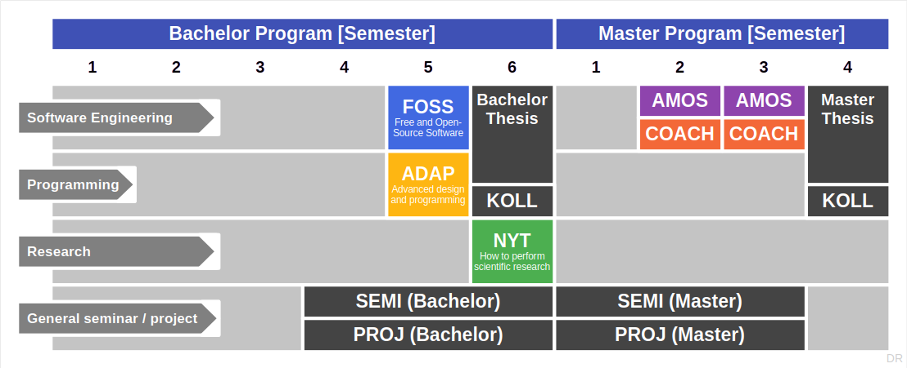
Course Position in Curriculum

Slide 5
Courses and Modules
 |  | Courses (Lehrveranstaltungen)
 |  | Lecture (2 SWS) | Exercise (2 SWS) |  | Total ECTS
Modules | COACH | x | x |  | 5

Slide 6
Availability of Modules
 |  | University
 |  | FAU Erlangen | TU Berlin | FU Berlin
Modules | COACH | x | – | –
 | AMOS-SM | – | x | –
x = available
– = not available

Slide 7
The Two Tasks of a COACH Student
As the Scrum Master
Coach team using agile capabilities timeline (explanation)
As a workshop facilitator
Prepare and hold workshop for your AMOS team

Slide 8
Holding Your Workshop
The workshop date is set in the AMOS course schedule
AMOS students are required to be there
You are responsible for reminding and managing students

Slide 9
COACH-VUE Grading [1]
Scrum Master = 50% of grade
Individual contribution to teamwork = 50%
As measured in team meetings
Grading scale is [0|1|2|3]
Independent (“self-study”) work = 50%
As measured by artifacts provided
Grading scale is [0|1|2|3]
Workshop facilitator = 50% of grade
Workshop concept (40%)
Workshop feedback (20%)
Workshop report (40%)
[1] See https://oss.cs.fau.de/teaching/course-resources/grading-schemes-and-scales/

Slide 10
Artifacts of Independent Work
Impediments backlog
Retrospective boards
Team meeting emails
Not this semester
Capabilities timeline
Development velocity

Slide 11
Course Management System
Please sign up on https://myc.uni1.de for the course [1]
Make sure your first and last name match your university credentials
[1] Please use your university email address; do not use GMX or web.de email addresses

Slide 12
Additional Rules
To pass the course, you must
Participate in (all) project team meetings
Participate in (all) weekly retrospectives (class sessions)
Perform the workshop and report about it

Slide 13
Receiving a Grade for the Course
Course management and exam registration are two separate things
If you want to receive a grade
You must register through your university’s exam registration system
Your degree program may have split the course into two (VL + UE)
Please check asap that the course is available in your degree program!
Otherwise: No grade

Slide 14

No Oral or Written Exam [1]
[1] You still have to register for the course

Slide 15
Course Language
Class
Lecturer: English
Student: Choice of German or English
Project
AMOS team: German or English
Homework: Choice of German or English

Slide 16
Course Organization
Course organization
See https://coach.uni1.de
Course schedule
See Schedule tab on Course organization doc

Slide 17
This Semester’s Projects
AMOS course organization
See https://amos.uni1.de
Coach to team allocation
By email

Slide 18
Work Rhythm
Lecture (class discussion)
Retrospective
Exercise (team meetings)
AMOS team meeting
Homework (self-organized)
See Course Organization doc

Slide 19
Course Communication
Announcements are sent by email
Through email aliases
Through course management system
Administrative questions to teaching team
Please ask your question in the COACH backchannel
For private questions, use the teaching team email alias

Slide 20
Thank you! Any questions?
dirk.riehle@fau.de – https://oss.cs.fau.de
dirk@riehle.org – https://dirkriehle.com – @dirkriehle

Slide 21
Legal Notices
License
Licensed under the CC BY 4.0 International license
Copyright
© Copyright 2024 Dirk Riehle, some rights reserved

